Slide 1
3D Photoacoustic Field Mapping System
Jinzhi Shen, Master Student
Mentor: Guo Chen
Advisor: Dr. Chen Yang
Department of Electrical & Computer Engineering, BU

Slide 2
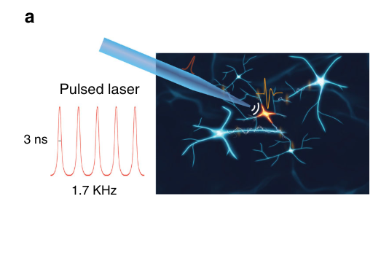
Photoacoustic Field
Yang’s lab has research focusing on developing “fiber-based optoacoustic converter” to produce ultrasound that could do neuromodulation. [1]
The ultrasound wave produced by the material could achieve submillimeter level spatial resolution which is accurate compare to old method like electrical stimulation. Ultrasound wave causes less damage to tissue than photothermal neural.
To able to analyse sample’s ultrasound field, the groups collected ultrasound intensity on sampling points to map out the behavior of the field.
Schematic of TFOE enabling single neuron stimulation[1]

Slide 3
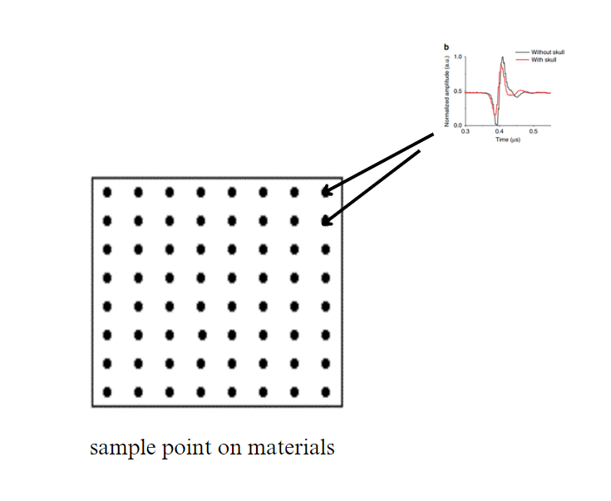
3D Photoacoustic Field Mapping System
Lack of machine helps, sampling points are taken by researchers moving sample points by hands which is time consuming and is a manual process.
To help address the issue, a 3D scanner that could do submillimeter level
field scanning could reduce time cost on the experiment. We also would like
to reduce the time in data collection such that a 20*20 sampling
points scan could be done within an hour.
Notes:
Lack of machine helps, sampling points are taken by researchers moving sample points by hands which is time consuming and is a manual process.

Slide 4
Aims of the project
Aim 1 : 3D scanner using an oscilloscope, Nema 17 step motors, and sequential programming in Matlab.
Aim 2: Allow data filter to improve graphic quality (FFT/Average)
Aim 3: Sparse Scanning strategy (to be explored in future)

Slide 5
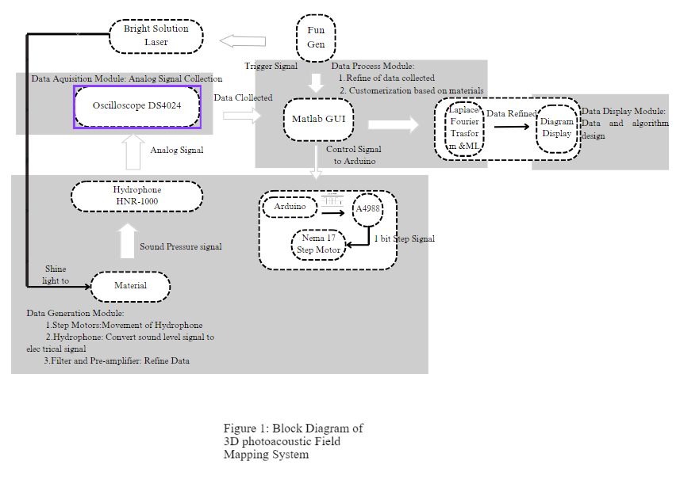
Project Schematic

Slide 6
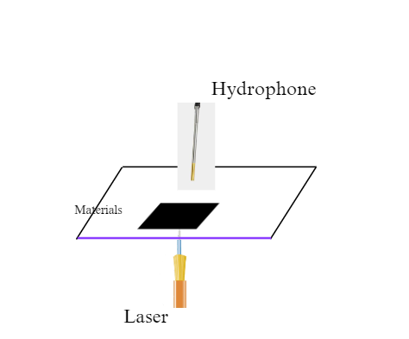
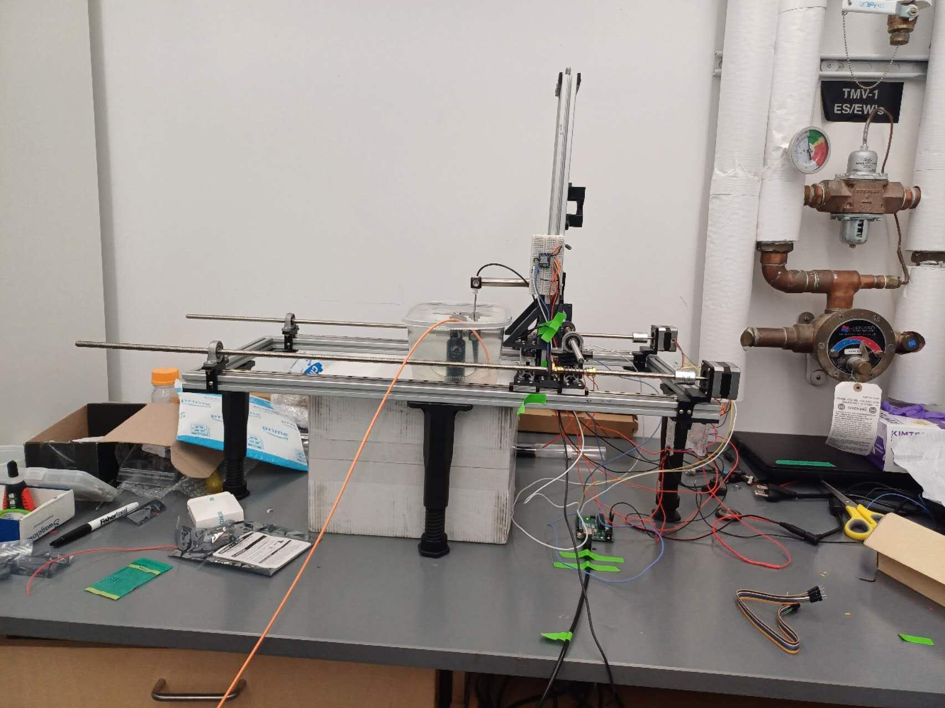
Mechanical Set Up

Slide 7
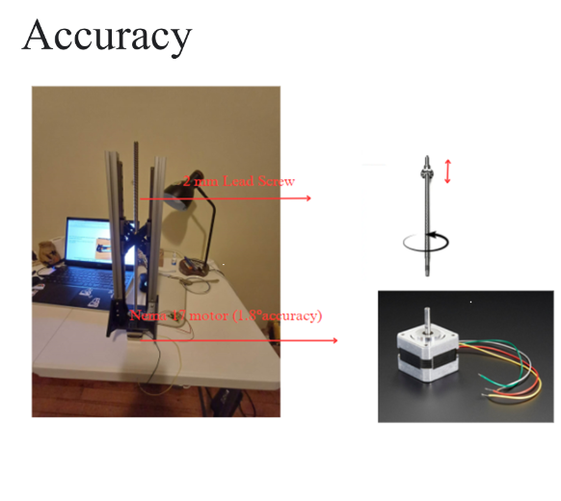
Physical Set Up
The block involves Step Nema 17 Motors and 2mm lead screw which could provides 1.8°/360°*2 mm = 10 μm accuracy.
The control of the motors achieve by Arduino and A4988 allows 4s motor motion speed.

Slide 8
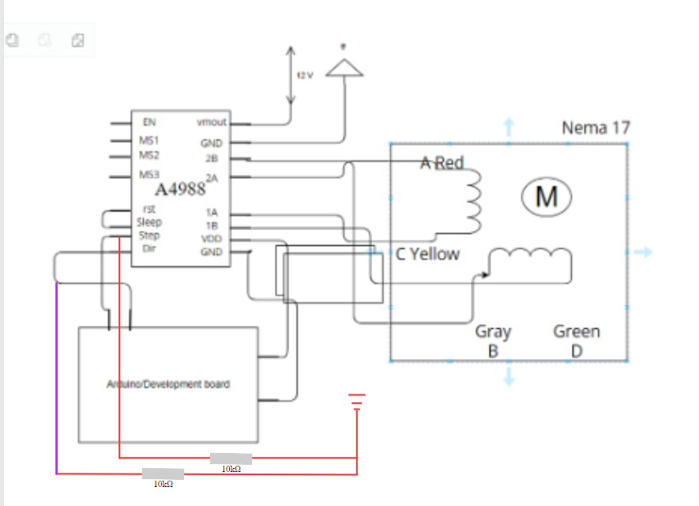
Set Up Pictures

Slide 9
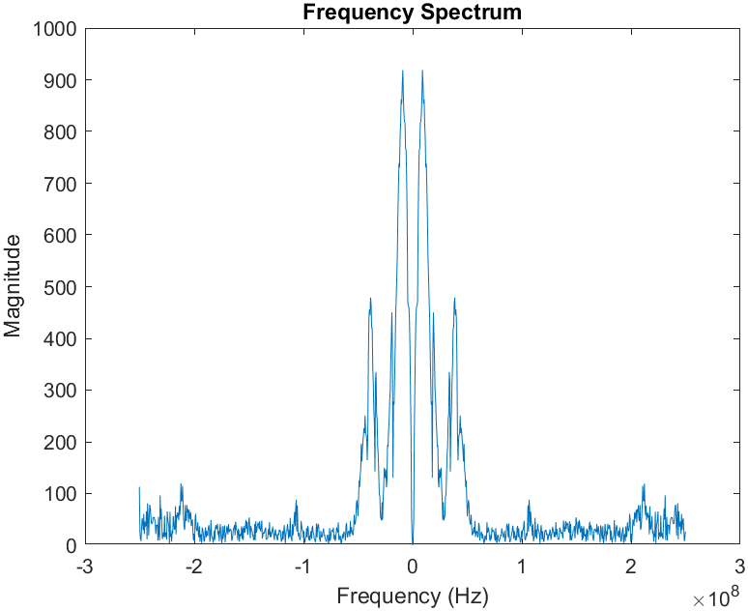
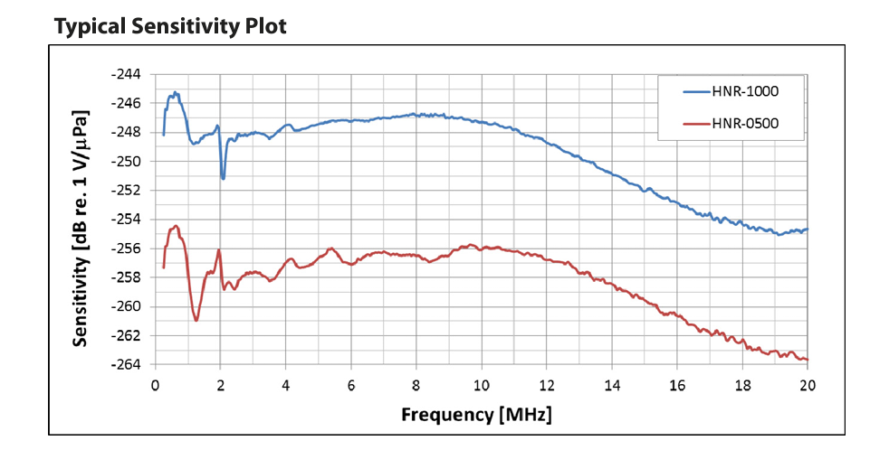
Data Collection
The data collection is done by ONDA HNR-1000 which could covert sound signal (AC) ranging from 0~20 MHz. In our test case, the central frequency of the sample is approximately 10MHZ. Oscilloscope DS 4024 has sampling rate up to 4G/s.

Slide 10
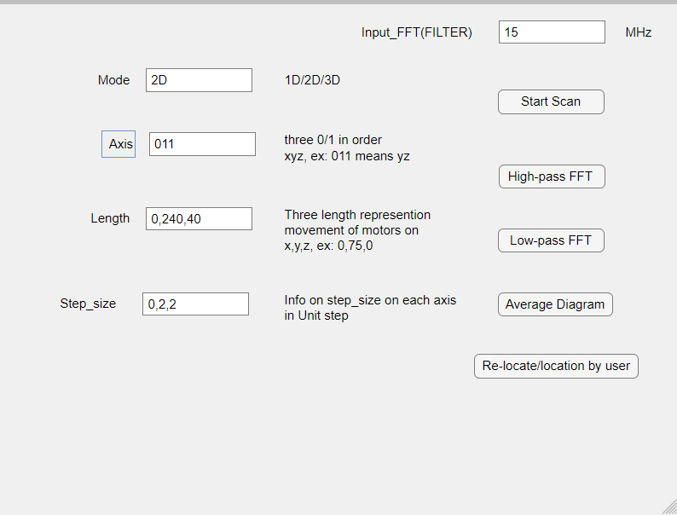
Software Setup
We use Matlab GUI to provide user with easy control over the whole system. The system support 1D/2D/3D scan and also FFT filters and data average method when generating graphs.

Slide 11
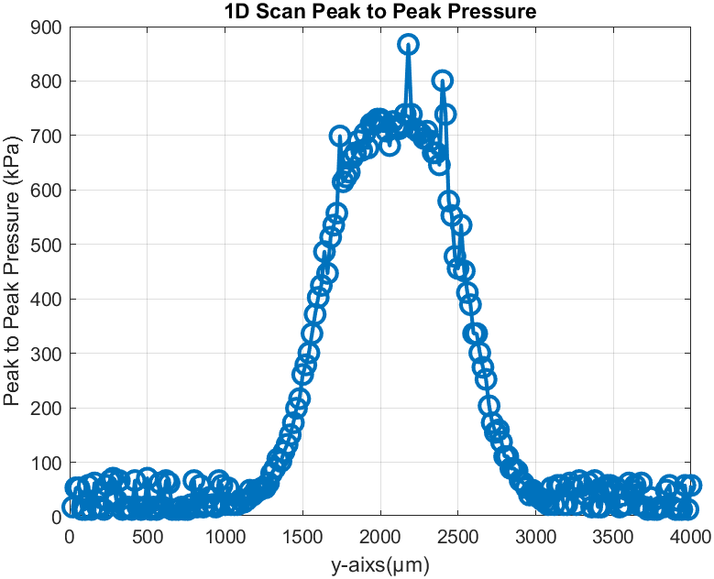
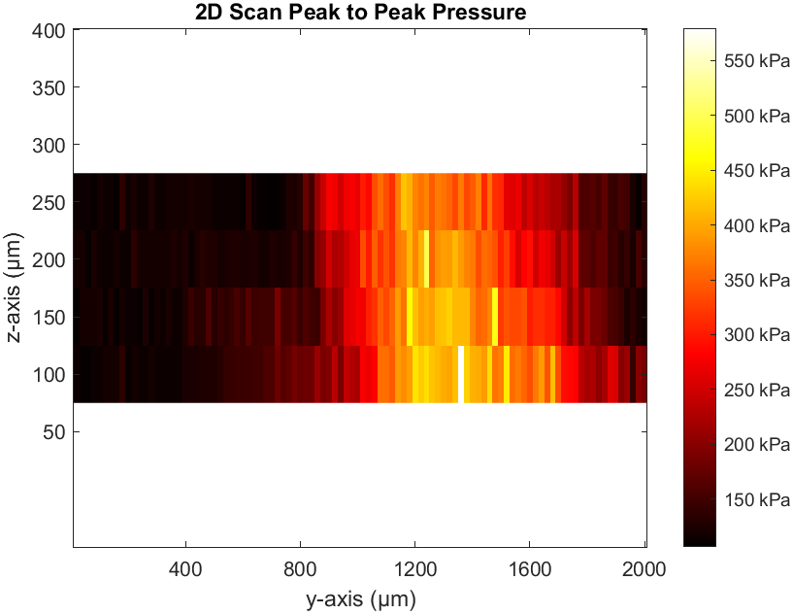
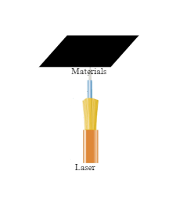
1D/2D Graphic
1D sample scan
2D sample scan
Notes:
1D: y -axis
2 stepsize
400 step
2D:

Slide 12
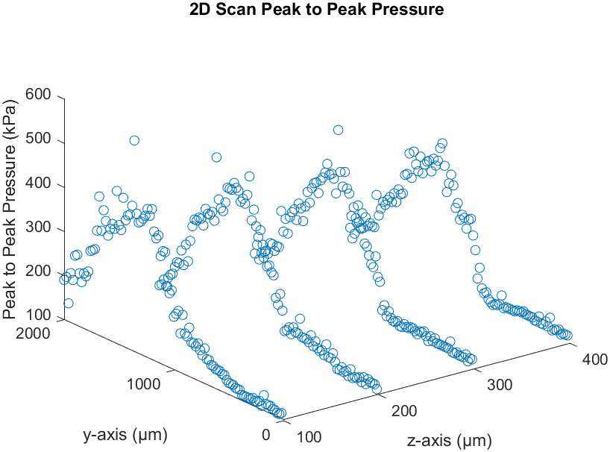
2D Scatter Plot

Slide 13
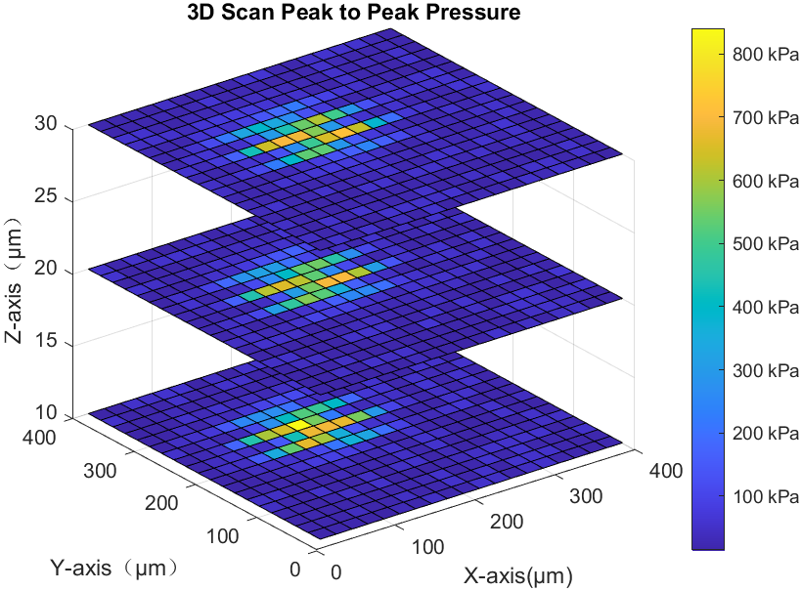
3D Graphic

Slide 14
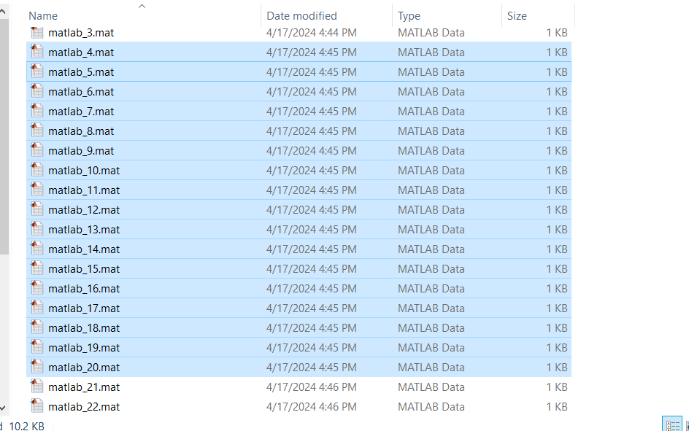
Sampling rate
The whole system could collect around 15 samples in one minute.
That will allow us possible to achieve a typical 3D scan that is 20*20*20 pixel in around 9 hours which is over night.

Slide 15
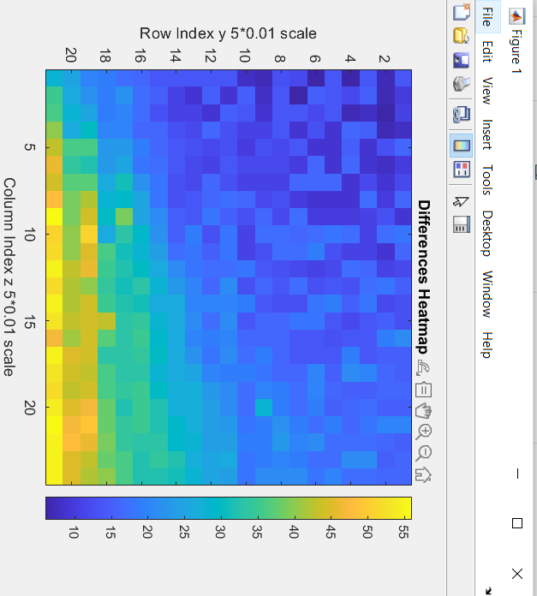
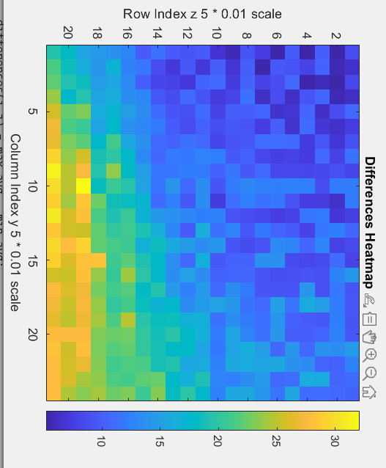
Average Graph
Original 2D scan sample
After Apply Average Way

Slide 16
References
[1] Shi, Linli et al. “Non-genetic photoacoustic stimulation of single neurons by a tapered fiber optoacoustic emitter.” Light, science & applications vol. 10,1 143. 14 Jul. 2021, doi:10.1038/s41377-021-00580-z
[2] Li, Y., Jiang, Y., Lan, L. et al. Optically-generated focused ultrasound for noninvasive brain stimulation with ultrahigh precision. Light Sci Appl 11, 321 (2022). https://doi.org/10.1038/s41377-022-01004-2

Slide 17
Thank you for your listening
Special thanks to Dr. Chen Yang, my mentor Guo Chen, Yueming Li and Zhiyi Du’s support during the project.

Slide 18
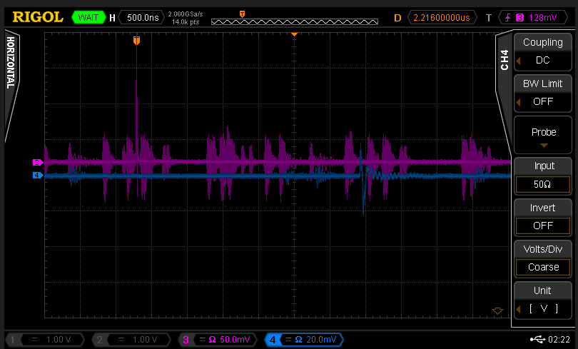
Notes:
This is backup slides in case people want to see exact PA signal on oscilloscope

Slide 19
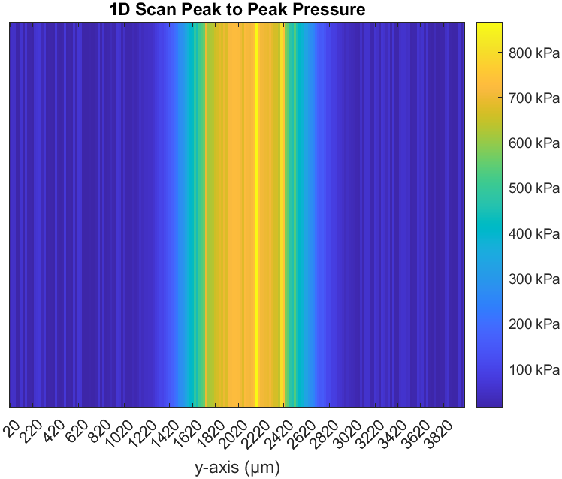
1D Color Map

Slide 20
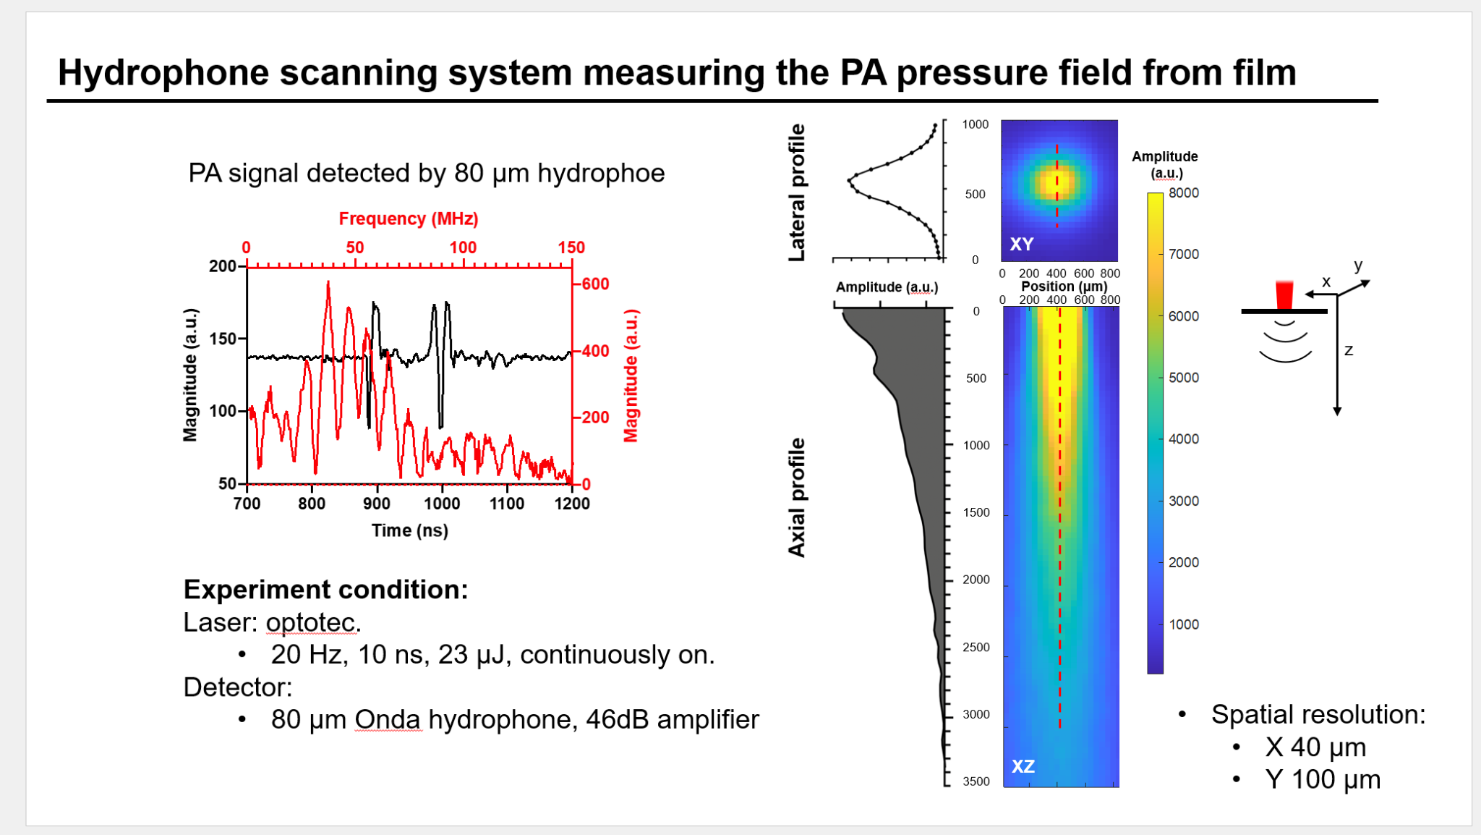
Notes:
Experiment Graph, could explain no obvious change on z-axis

Slide 21
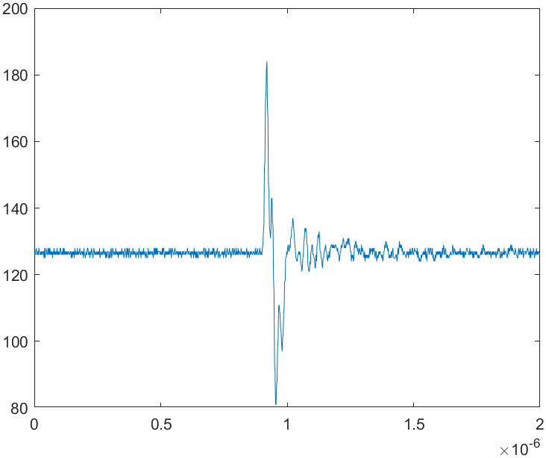

Slide 22
